Slide 1

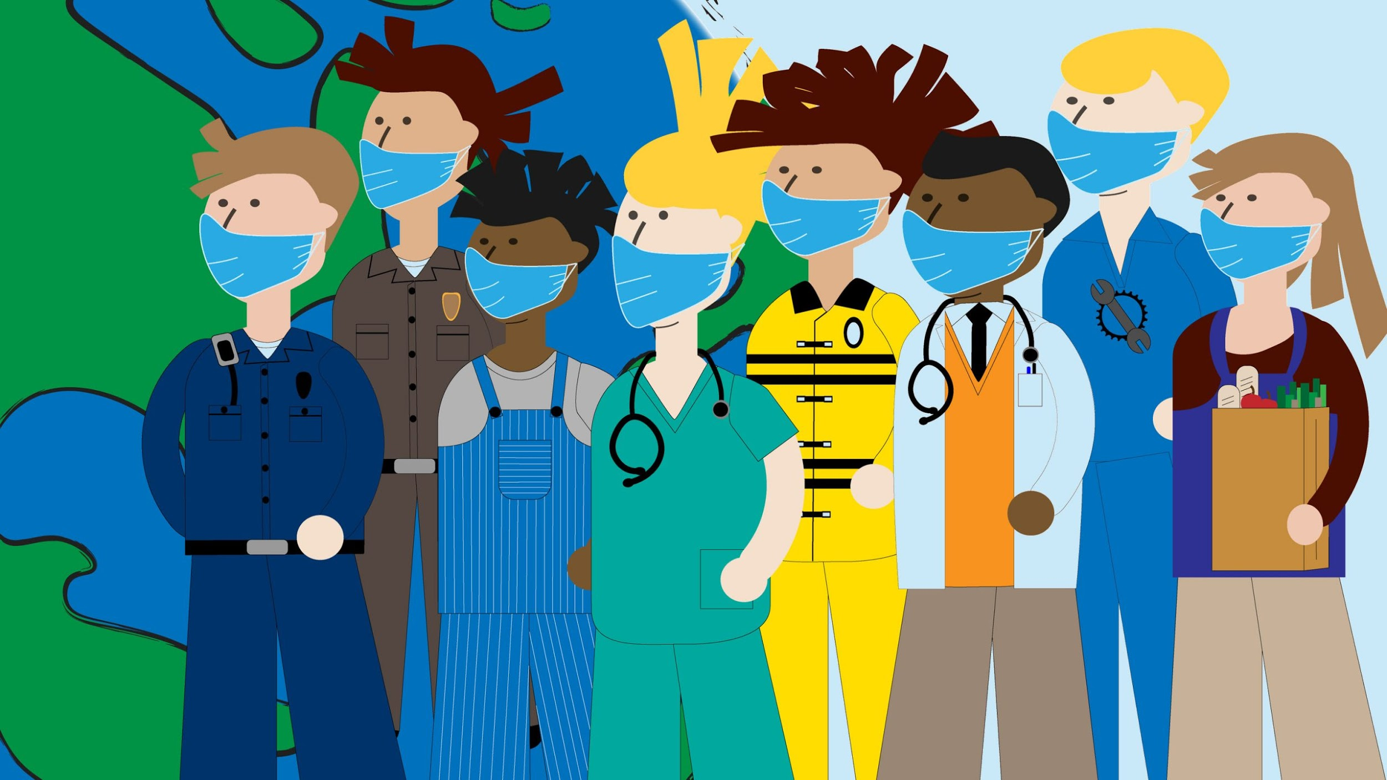
COVID CARE
PRESENTED BY (Team 16):
BIBEK POKHAREL
BIBEK SITAULA
NIRAJ DEVKOTA
PRANAYA SHARMA
SURAJ KUMAR BHETUWAL

Slide 2
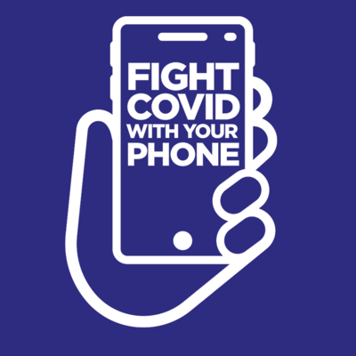
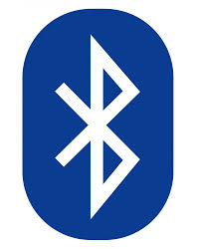
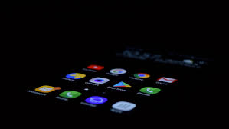
Tools Required
Android Studio
Android device
Bluetooth signal device
Object Programming Language, Java

Slide 3
Problem Description
Expected millions of new cases and deaths worldwide at the end of 2021
Negligence of people spread the virus even more
Really hard to trace affected people around us
People are scared to get vaccinated because of unreliable information
Economic crisis due to rapid increases in covid cases
Difficulty in business due to change in business hours and its structure in response to virus

Slide 4
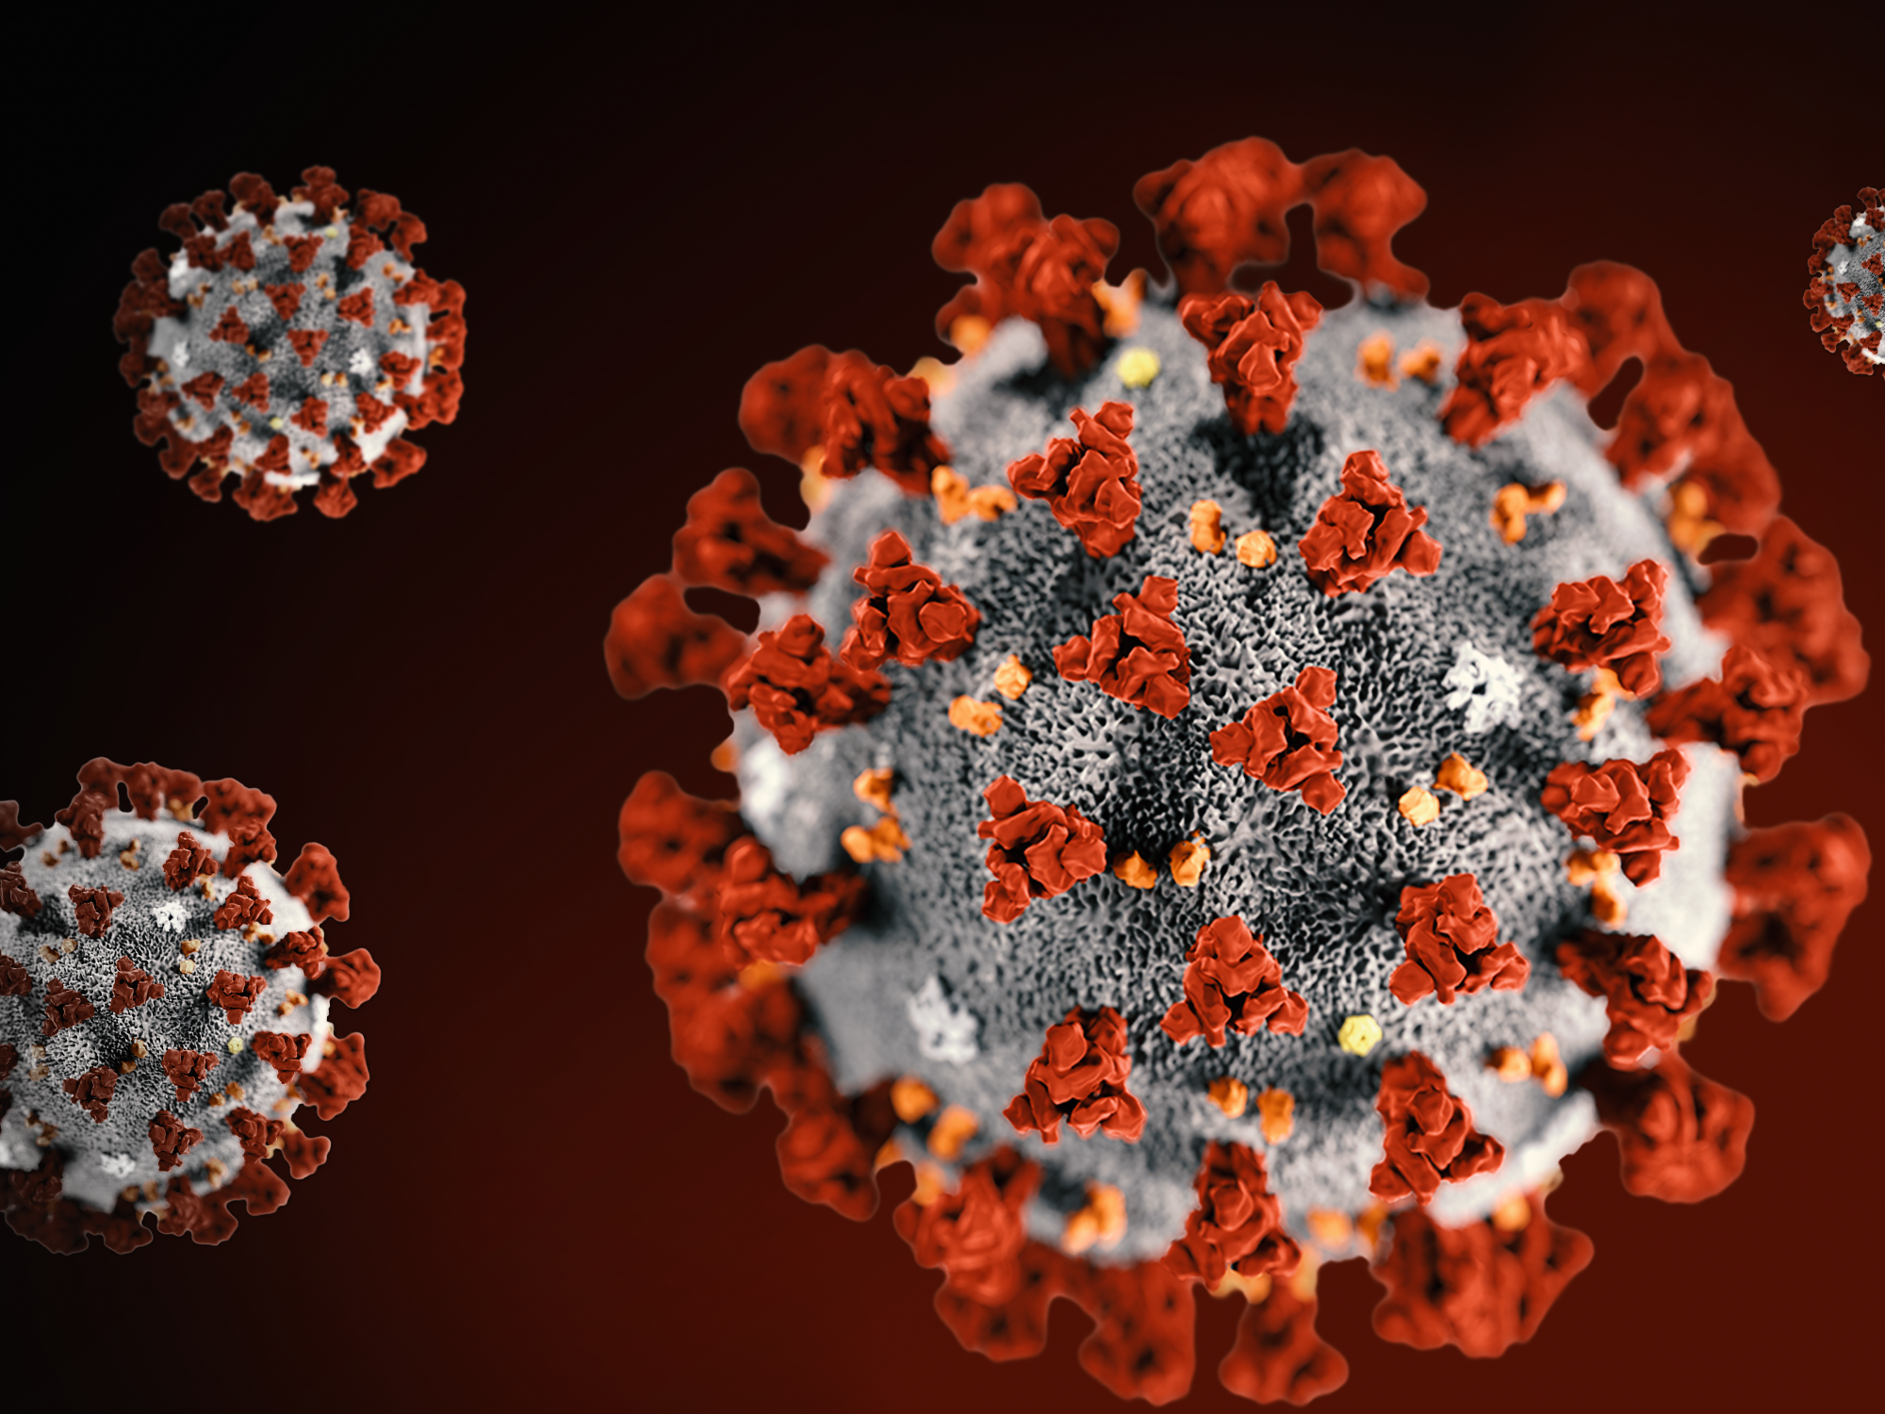
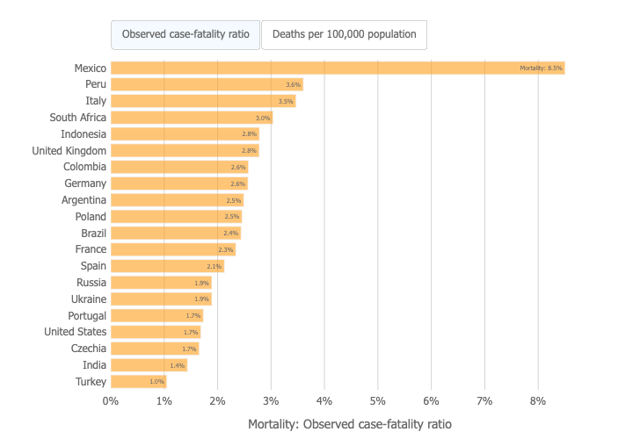
Mortality Analysis

Slide 5
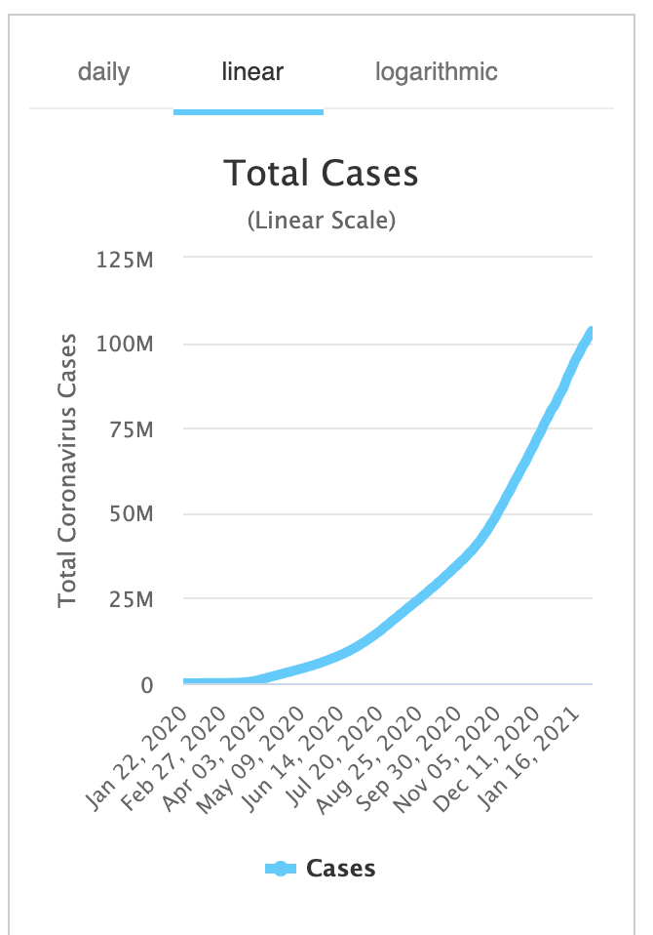
Motivation
As of now, almost 104 million cases and 2.5 million deaths worldwide
Absence of real time data to alert from the Covid patients exposed area
Inaccurate data and information in several platform
Current reliable online platform are not easily accessible to everyone
No platform for the users to review vaccination and provide feedbacks

Slide 6
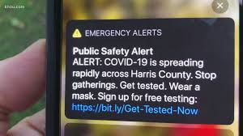
Main Idea
Implementing similar ideas as Amber Alert to push notification alert about nearby expose area.

Slide 7
Functionality & Features
Provide map based data on real time indicating high and low risk areas
Notify the user via Bluetooth device if someone covid affected is nearby
System will provide the information about availability of vaccine in nearby Hospitals and Pharmacy to make appointments
Allows the vaccinated patients to provide feedback regarding their experience on the daily basis
Allows business organization to create profile, include all their business hours and update expected changes about their operations
System will allow the user to update their emergency contact which may be used to let them know if user gets affected by COVID-19

Slide 8
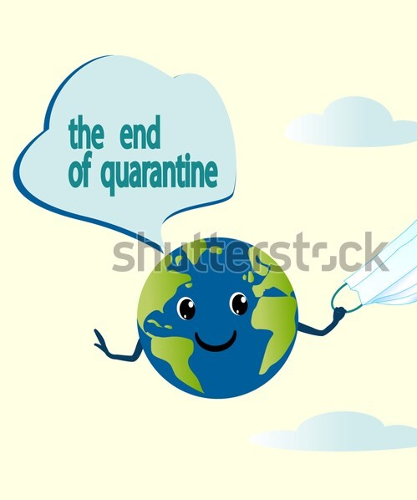
Expected outcomes
Decrease in number of COVID patients
Easy to track COVID-19 patient and prevent exposures
People getting first and second dose vaccination at proper times and places
Easy to track the vaccine records from first phase to second phase
Getting reviews and updates of vaccination from vaccinated people via app
Avoid highly risky areas using the map

Slide 9
Reference
Coronavirus Cases: (n.d.). Retrieved January 30, 2021, from https://www.worldometers.info/coronavirus/
Symptoms of Coronavirus. (n.d.). Retrieved January 30, 2021, from https://www.cdc.gov/coronavirus/2019-ncov/symptoms-testing/symptoms.html
Herman, T. (2020, May 12). Thank you to workers on the frontlines of COVID-19 [image]. Retrieved February 02, 2021, from https://and.flintandgenesee.org/thank-you-to-workers-on-the-frontlines-of-covid-19/
Liubovart. (n.d.). Quarantine end concept. Planet Earth is freed from the mask, from the coronavirus, from the epidemic [Image]. Retrieved February 02, 2021, from https://www.shutterstock.com/image-vector/quarantine-end-concept-planet-earth-freed-1717480045
Mortality Analyses. (2021) [image]. Retrieved February 02, 2021, from https://coronavirus.jhu.edu/data/mortality

Slide 10
Thank you!

